Slide 1
KEY HIGHLIGHTS
AI-Powered
Study Assistant
🤖 Groq AI (LLaMA 3.3)
Generates flashcards, quizzes & summaries
📄 PDF Upload
Extract & process lecture notes instantly
Transforming Notes into Knowledge
with AI, Automation & Smart Reminders
🎯 Difficulty Levels
Easy, Medium, Hard — personalized learning
📱 WhatsApp Reminders
Presented by: G. Naina
Roll no: 24071A6791
Daily automated study reminders via n8n

Slide 2
Problem Statement
WHY THIS PROJECT?
📚 Manual Note Processing
⏰ Inconsistent Revision
Students spend hours manually creating flashcards and summaries from lengthy lecture notes.
Without structured reminders, students forget to revise regularly, leading to poor retention.
🎯 One-size-fits-all Learning
📄 Unstructured PDFs
Existing tools don't adapt content difficulty to individual student needs.
Most study materials exist as PDFs with no automatic extraction or AI processing.

Slide 3
Solution Overview
WHAT WE BUILT
An AI-powered web application that automatically transforms lecture notes and PDFs into flashcards, summaries and quizzes — with adjustable difficulty and daily WhatsApp reminders.
🃏
📝
🧠
🎚️
📱
Flashcards
Summary
Quiz Mode
Difficulty
Reminders
Auto-generated Q&A cards from notes
Concise summaries at chosen difficulty
5-question MCQ quizzes with answers
Easy / Medium / Hard adjustment
Daily WhatsApp alerts via n8n + Twilio

Slide 4
Tech Stack
TECHNOLOGIES USED
Frontend
Backend
HTML5, CSS3, JavaScript
PDF.js for PDF extraction
Responsive UI Design
Node.js + Express.js
Axios for API calls
dotenv for security
AI / LLM
Automation
Groq API
LLaMA 3.3 70B model
Smart text chunking
n8n workflow tool
Twilio WhatsApp API
Daily schedule trigger

Slide 5
System Architecture
HOW IT WORKS
1
2
3
4
5
Student
Uploads PDF
Frontend
Extracts Text
Backend
Processes
Groq AI
Generates
Results
Displayed
n8n Automation Layer
Schedule Trigger → runs daily at 9:00 AM → Twilio Node → sends WhatsApp reminder to student
Reminder: "Good morning! Time to study! Open your Study Assistant and review today's notes."

Slide 6
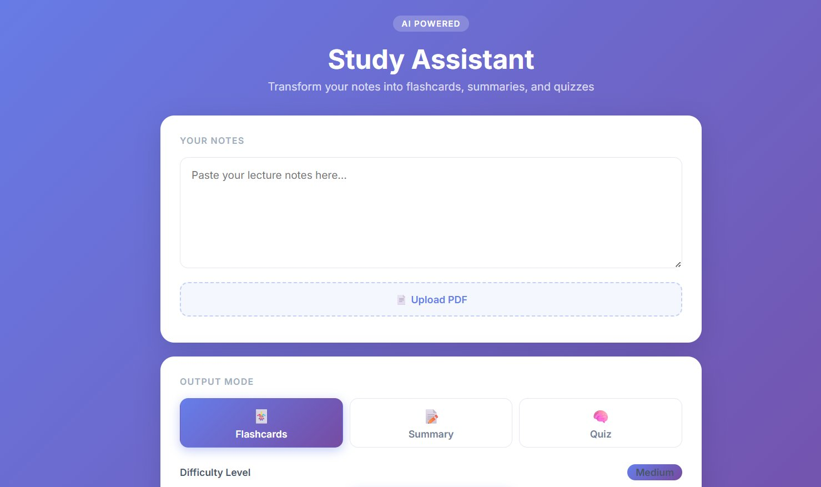
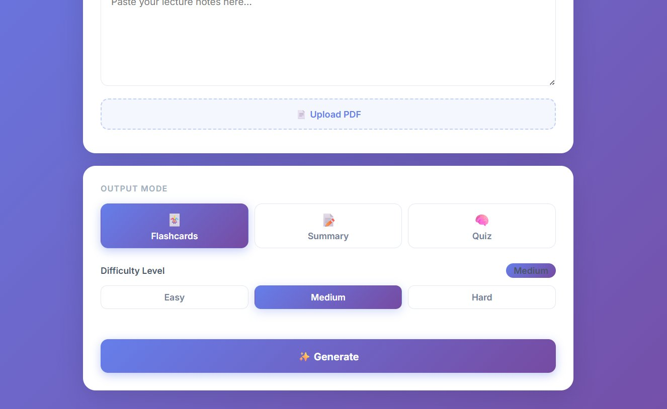
Implementation
ACTUAL APPLICATION SCREENSHOTS
Dashboard — Notes Input & Mode Selection
Difficulty Buttons & Generate Feature
📄 PDF Upload
🃏 Flashcards
📝 Summary
🧠 Quiz
🎚️ Difficulty

Slide 7
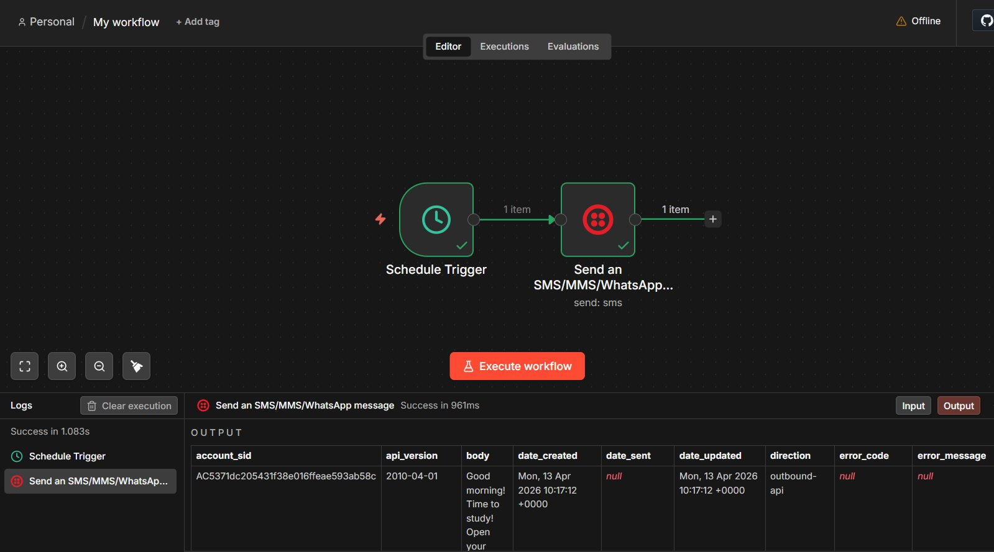
n8n Automation Workflow
ACTUAL WORKFLOW SCREENSHOT
Schedule Trigger fires daily at 9am → Twilio Node sends WhatsApp to student → ✓ Success in 1.083s

Slide 8
Key Features
WHAT THE APP CAN DO
📄
🃏
📝
PDF Upload & Extraction
Flashcard Generation
Smart Summaries
Upload any lecture PDF. PDF.js extracts all text automatically across all pages.
AI generates 5 Q&A flashcards from your notes in Front/Back format.
Concise summaries tailored to Easy, Medium or Hard difficulty level.
🧠
🎚️
📱
Quiz Generation
Difficulty Control
Daily WhatsApp Alerts
5 multiple choice questions with answers based on uploaded content.
3-level difficulty buttons adjust AI content complexity for any learner.
n8n + Twilio sends automated daily reminders at 9am via WhatsApp.

Slide 9
Challenges & Solutions
WHAT WE OVERCAME
⚠ Deprecated AI model (mixtral-8x7b)
→
✓ Switched to llama-3.3-70b-versatile on Groq API
⚠ Rate limit with 16-page PDFs
→
✓ Implemented text chunking — sends only first 9,000 chars
⚠ API key security risk
→
✓ Used .env file + dotenv package to protect credentials
⚠ Port conflict (EADDRINUSE)
→
✓ Used npx kill-port 3000 before restarting server
⚠ Difficulty slider frozen in browser
→
✓ Replaced range slider with 3 clickable buttons (Easy/Medium/Hard)

Slide 10
Future Scope
WHERE WE GO FROM HERE
🔐
📊
📎
User Authentication
Progress Dashboard
PPT & Word Support
Login system to save flashcard history and progress
Track study streaks, scores and revision history
Extend file upload to support .pptx and .docx formats
🔁
🌍
📲
Spaced Repetition
Multi-language
Mobile App
Smart algorithm to resurface forgotten flashcards
Support regional languages for wider accessibility
Native iOS and Android app for on-the-go studying

Slide 11
Thank You!
AI-Powered Study Assistant
Built with Node.js • Groq AI • n8n • Twilio

